Slide 1
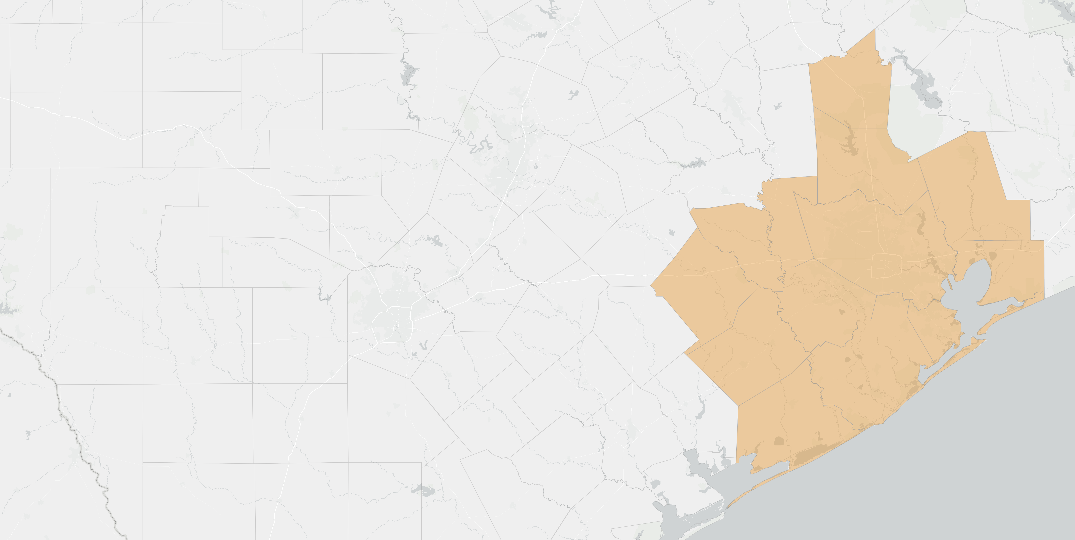

Labor Market Update June 25, 2020:
Impacts of COVID-19 to-date
www.wrksolutions.com 1.888.469.JOBS (5627)
Workforce Solutions is an equal opportunity employer/program. Auxiliary aids and services are available upon request to individuals with disabilities.
(Please request reasonable accommodations a minimum of two business days in advance.) Relay Texas: 1.800.735.2989 (TDD) 1.800.735.2988 (voice) or 711

Slide 2
Topics
The May 2020 Houston MSA Jobs Report
The May 2020 (Surprising) National Jobs Report
UI Claims and Their Evolving Significance in the Near-term
Trends in Job Ads
2
Gulf Coast Workforce Board

Slide 3
Employment
3

Slide 4
Houston MSA OTM Total Nonfarm Change May 2020
Not Seasonally Adjusted
+73,800
Largest one-month gain on record
Implies 1 in 5 of 350k jobs lost Mar-April recovered
4
Notes:
More jobs in single month than typically added in a year

Slide 5
Houston MSA Sectors Adding Most Jobs OTM and Implied Recovery Rate
May 2020
5
Notes:
“OTM Rebound Sectors”

Slide 6
Houston MSA Sectors Losing Most Jobs OTM and Cumulative Percent Loss March – May 2020
6
Notes:
“OTM Sectors with Continued Losses” The first major leg down in upstream oil and gas was driven by the initial COVID-19 shockwave but low oil prices and a sharp decline in the rig count have provided additional follow through to the downside.

Slide 7
Houston MSA Government Employment May 2020
Federal Government Decennial Census jobs missing due to COVID-19
State and Local Govt. Education seasonal losses pulled forward from June
Possible signs of Local Govt. Non-Ed. losses due to falling sales tax receipts
7
Notes:
2020 Decennial Census marks the first time that people can respond online, by phone, or by mail. May typically the peak data collection phase of the Census. Some field data collection allowed to resume on May 4th. The legal deadline for reporting counts to president for House of Representatives apportionment now delayed until nearly May 2021.

Slide 8
Houston Metro Unemployment Rate
8

Slide 9
Houston MSA Unemployment Rate May 2020
Not Seasonally Adjusted
13.9%
9

Slide 10
Houston MSA Unemployment Rates & Unemployed Persons (NSA)
February – May 2020
Unemployed:
+8,300
Employed:
+129,000
10

Slide 11
Houston MSA Unemployment Rate (NSA)
May 1990-2020
Official declaration February 2020 start of current recession by NBER
11
Notes:
Region unemployment rate now nearly five and a half (technically 5.4) percentage points higher than the highest rate during the Great Recession. A year ago this time our unemployment rate was at an all-time low. Now we’re at an all-time high.

Slide 12
Regional Unemployment Rates
12

Slide 13
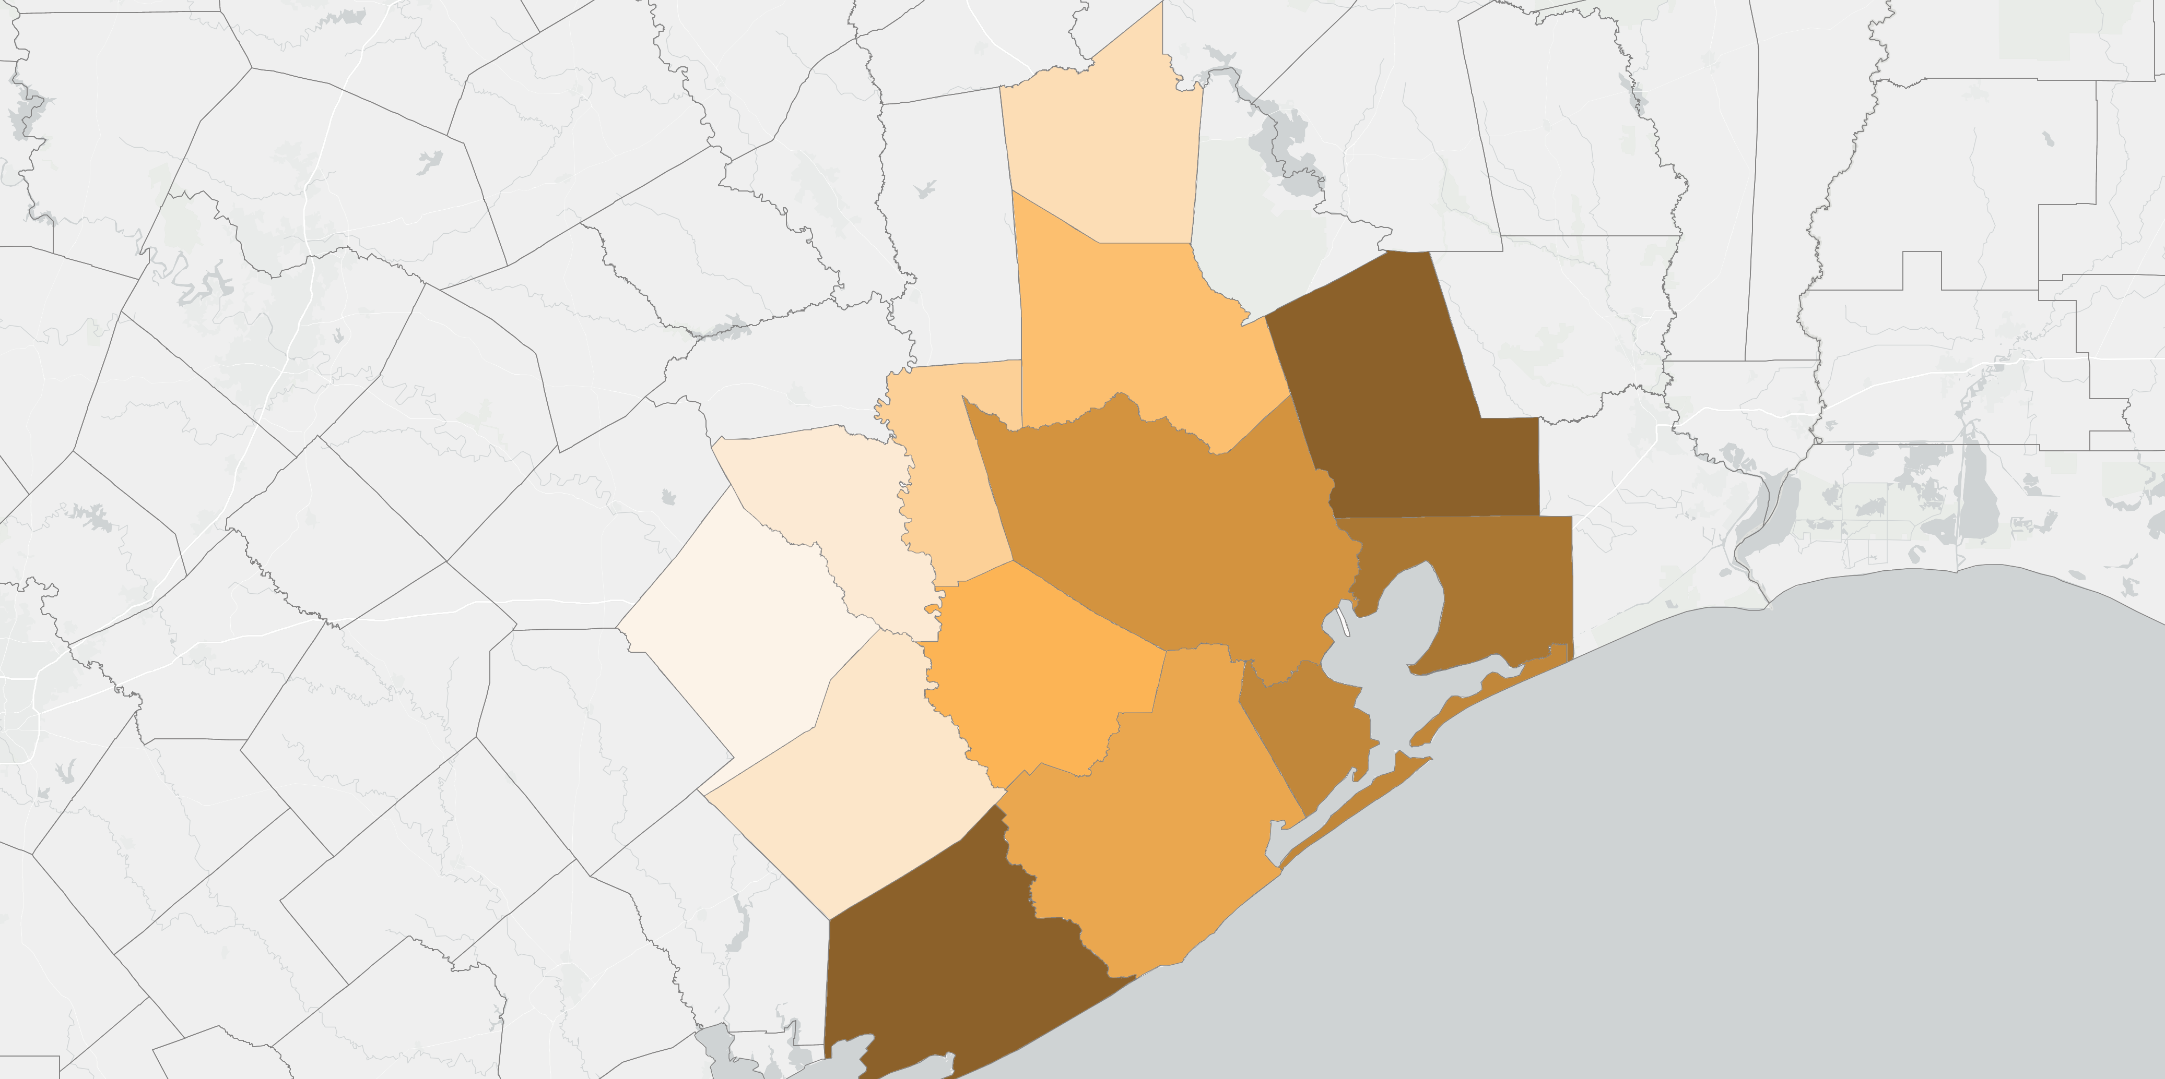
13-County Gulf Coast Region Unemployment Rates May 2020
Walker
10.8
13-County
Gulf Coast
Average:
13.9
Montgomery
12.5
Liberty
15.5
Austin
9.8
Waller
11.9
Galveston now 4th highest rate after 1st in April
Largest OTM drop from April to May of 13 counties
Largest 1-month drop on record
Harris
14.3
Chambers
14.7
Colorado
8.2
Fort Bend
12.8
Only counties to STILL NOT exceed their previous all-time high UE rates as of May
Wharton
9.9
Brazoria
13.4
Galveston
14.5
Liberty and Matagorda Counties have re-emerged as counties with highest rates consistent with historical trends over past 30 years.
Matagorda
15.3
Source: Bureau of Labor Statistics/Texas Workforce Commission

Slide 14
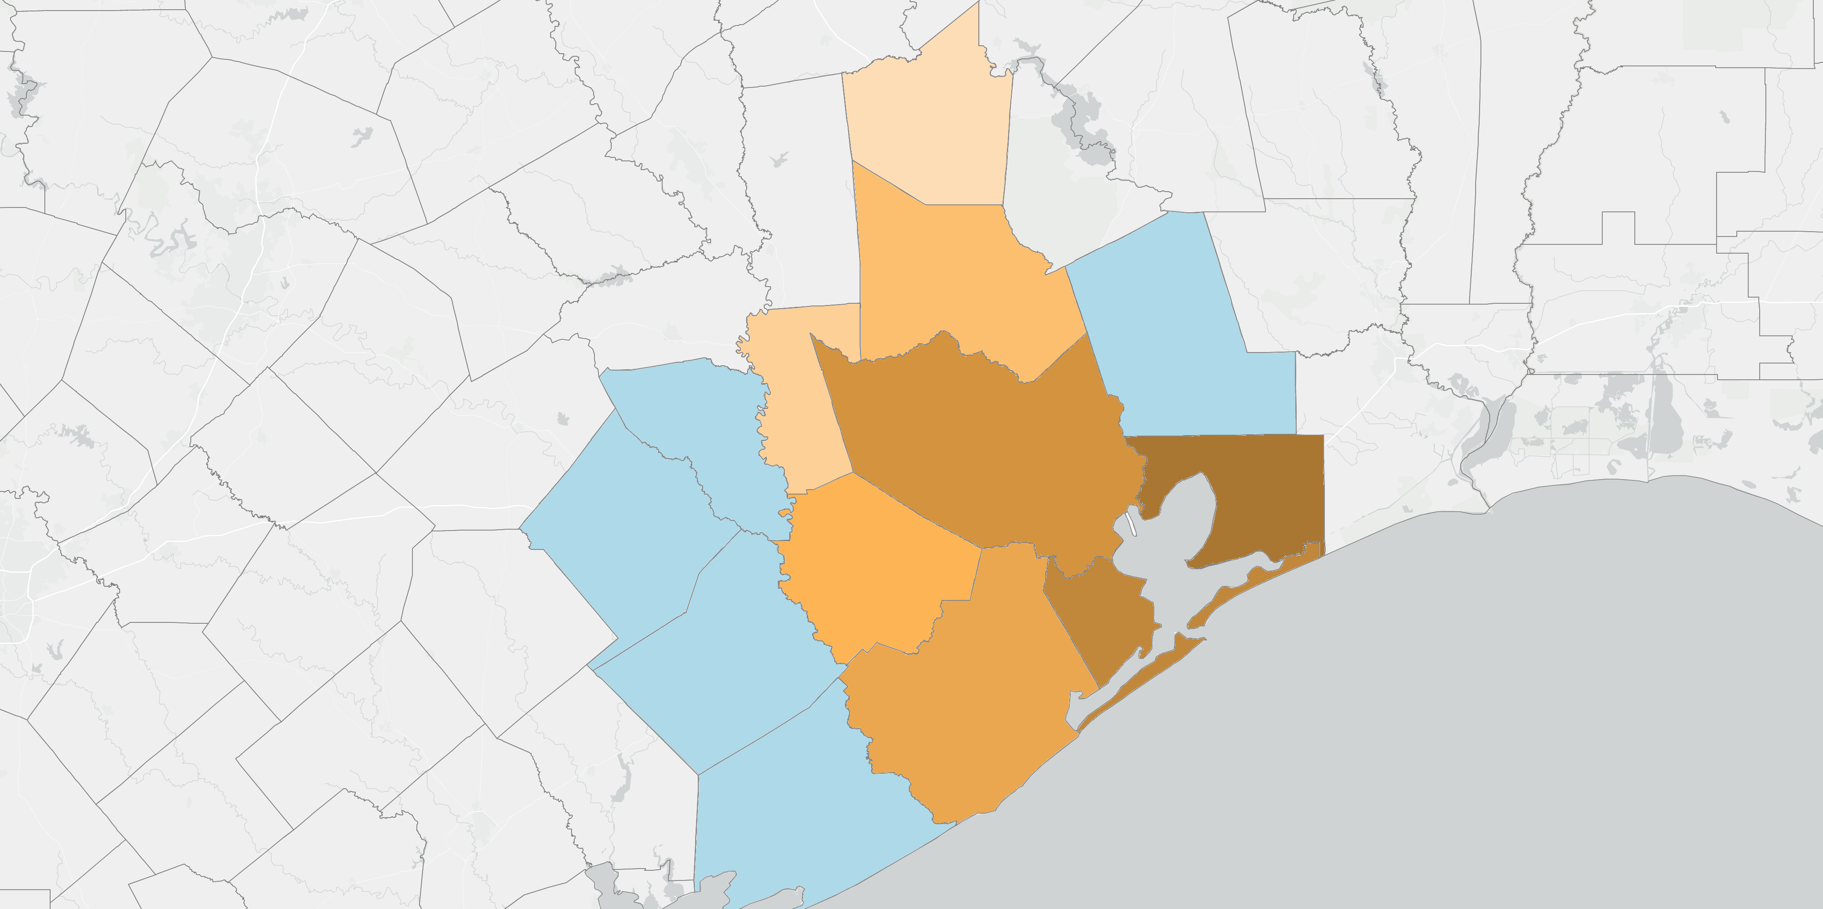
13-County Gulf Coast Region Unemployment Rates May 2020
Walker
10.8
13-County
Gulf Coast
Average:
13.9
Montgomery
12.5
Liberty
15.5
Austin
9.8
Waller
11.9
Harris
14.3
Overall rate for region fell BUT rates continued to rise in 5 of 13 counties:
Chambers
14.7
Colorado
8.2
Fort Bend
12.8
Wharton
9.9
Brazoria
13.4
Galveston
14.5
Matagorda
15.3
Source: Bureau of Labor Statistics/Texas Workforce Commission
Notes:
Note at the county level, the 3 highest rates, which all happen to be above 15%, are all concentrated on the east side of the region. This is only the 2nd time Galveston County has had the highest rate in the region but it’s not surprising given Galveston, particularly the island’s, reliance on restaurants, tourism, retail, which were the most directly impacted industries as a result of the stay-at-home orders.
Lastly, all but 2 of our counties have seen their previous all-time high unemployment rates, most of which occurred back during the Great Recession, broken with April’s numbers, Colorado which traditionally has had the lowest rate in the region, as is the case here, and Matagorda which traditionally has had the highest rate in the region.

Slide 15
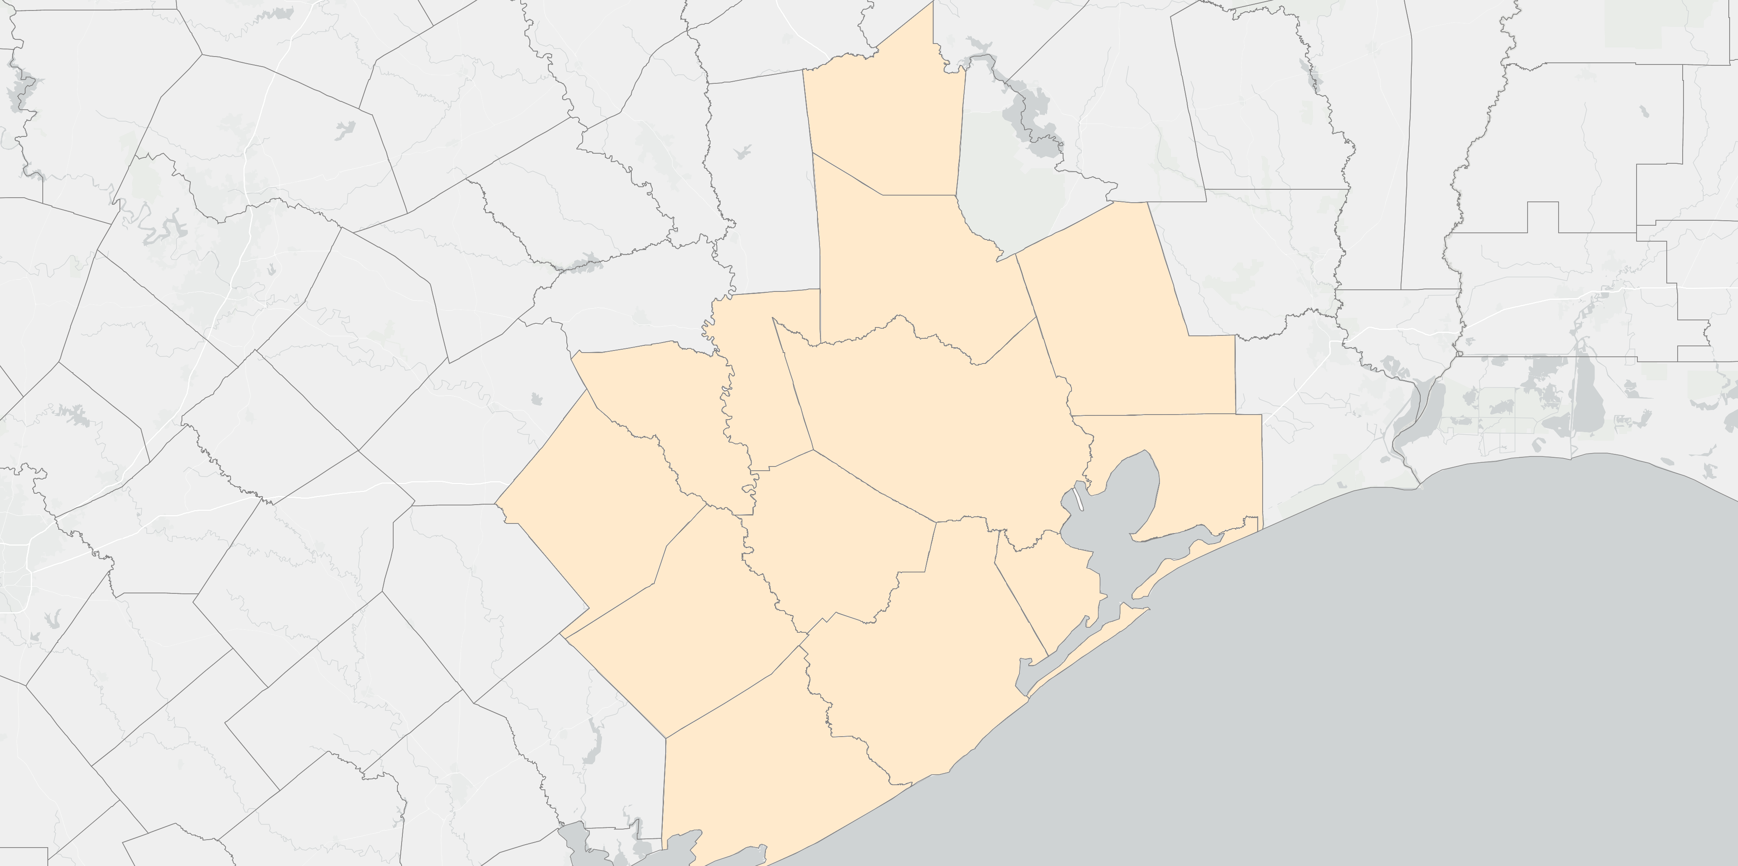
13-County Gulf Coast Cities Unemployment Rates April 2020
8
13-County
Gulf Coast
Average:
13.9
3
All but 2 cities saw UE rates fall or no change Apr-May
7
4
2
16
12
13
15
14
5
9
1
11
17
Galveston City
Largest ppt decrease of 17 cites in region Apr-May
-2.2 ppt
6
10
15
Source: TWC/BLS
*Note: unemployment rates available for only the 17 cities shown.

Slide 16
Commentary on May 2020 Employment Situation
16
Notes:
Here’s what I’ll say. I’m surprised that both the national jobs report for May and the local one were able to capture what is potentially an inflection in the current recession within the same month that it occurred. Typically the jobs numbers lag because of reference point in the month of survey but Ma

Slide 17
May 2020 National and Local Employment Situation
Nationally
  Total Nonfarm Employment: +2.5 million jobs OTM
  U-3 Unemployment Rate: (14.7% to 13.3% SA) (14.4% to 13.0% NSA)
  Consensus TNF forecast: loss of -7.5 to -8.3 million jobs
  Consensus UE rate forecast: increase to 19.0%
  10 to 13 million new UI claims since April jobs report
Locally
  UI Claims data implied 19% unemployment rate with a loss of ~100k jobs
17

Slide 18
Reopening and Job Report Survey Timeline May 2020
Jobs report surveys reference the week that includes the 12th of the month (e.g. 5/10 – 5/16)
Second round of PPP loans available after 4/27¹
5/1: restaurants, retail allowed to reopen at 25% capacity¹
5/8: Salons, barbershops, etc. allowed to reopen at 25%¹
5/22: restaurants, retail increase to 50% capacity; bars at 25%¹
6/5: Kemah Boardwalk and Galveston Pleasure Pier reopen¹
6/12: restaurants, retail allowed 75% capacity; bars at 50%¹
Houston area new UI claims between April and May jobs reports: 110k – 150k
Expanded UI benefits in effect through July
18
¹Source: Houston Chronicle
Notes:
All of these milestones/factors had to line up perfectly or be fully discounted to result in what we saw locally or nationally.

Slide 19
Houston MSA Total Nonfarm Absolute Employment
May 2015 – May 2020
Real-time inflection point in the recession
?
19
Notes:
Note the absence of a period slowing decline before reaching a bottom and rebounding.
Suggests that the surveys were able to capture an inflection point in the economy in real-time rather than with a lag as is usually the case.

Slide 20
What does it mean for the local unemployment rate going forward?
20

Slide 21
13-County Region Weekly Initial Unemployment Insurance Claims
Week and Percent Change from Previous Week
March 7 to June 13
Weekly claims now down -70% from April highs
21
Notes:
The week-over-week change in claims has been falling for the 3 most recent weeks of data available.

Slide 22
13-County Region Cumulative Initial Unemployment Insurance Claims
Week of March 7 to June 13
June
??%
May
13.9%
April
14.3%
77,000 additional claims since 5/23
March
5.6%
117,000 claims
4/25 – 5/16
22
Notes:
With the May release, initial weekly claims may have lost their utility as a preview of the unemployment rate going forward largely due to reopening which complicates analysis of in-flow i.e. new unemployed individuals vs. outflow i.e. people finding jobs and exiting unemployment.

Slide 23
13-County Region Continuing Unemployment Insurance Claims
May 1990 – May 2020 (monthly averages)
23
Notes:
Only monthly continuing claims as of 12th of month available at time of release of monthly jobs report.

Slide 24
Share of UI Claimants by Self-reported Ed. Attainment
24

Slide 25
Job Ad Trends
25

Slide 26
13-County Gulf Coast Region Daily Active Job Ads
March 1st - June 23rd 2019 vs. 2020
26

Slide 27
Gulf Coast 30-Days over 30-Days Net and Percent Change Job Ads by Industry Sector
(June, 23 2020 to May, 24 2020 over May, 23 2020 to April, 23 2020)
27
Notes:
Some of you will recall last time that it was necessary to sift through the data and look for individual employers to see who’s hiring. Now you have a better of finding an employer in just about every industry sector that’s hiring.

Slide 28
Gulf Coast 30-Days over 30-Days Net and Percent Change Job Ads by Occupational Family
(June, 23 2020 to May, 24 2020 over May, 23 2020 to April, 23 2020)
28

Slide 29
Thank You!
Parker A. Harvey
Principal Economist
Gulf Coast Workforce Board/Workforce Solutions
713-993-2462
parker.harvey@wrksolutions.com

